Slide 1

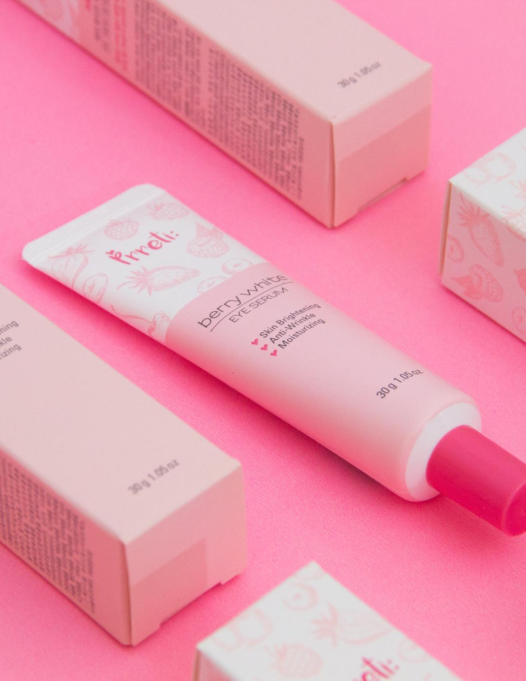
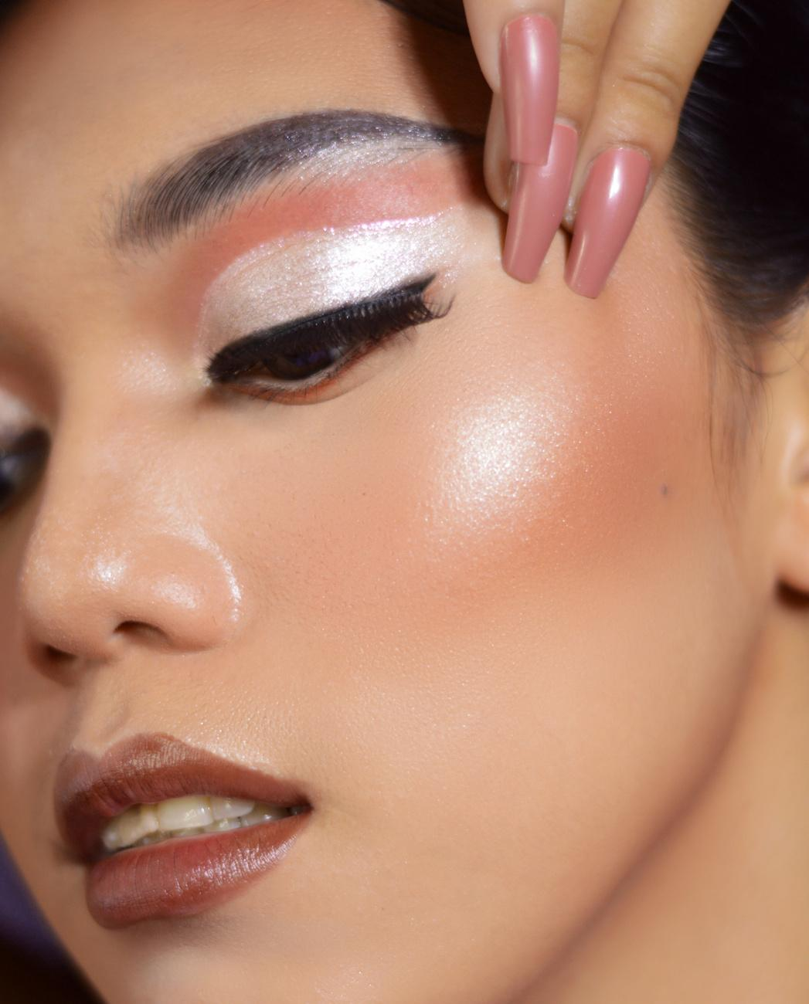


Nykaa Analysis

Slide 2

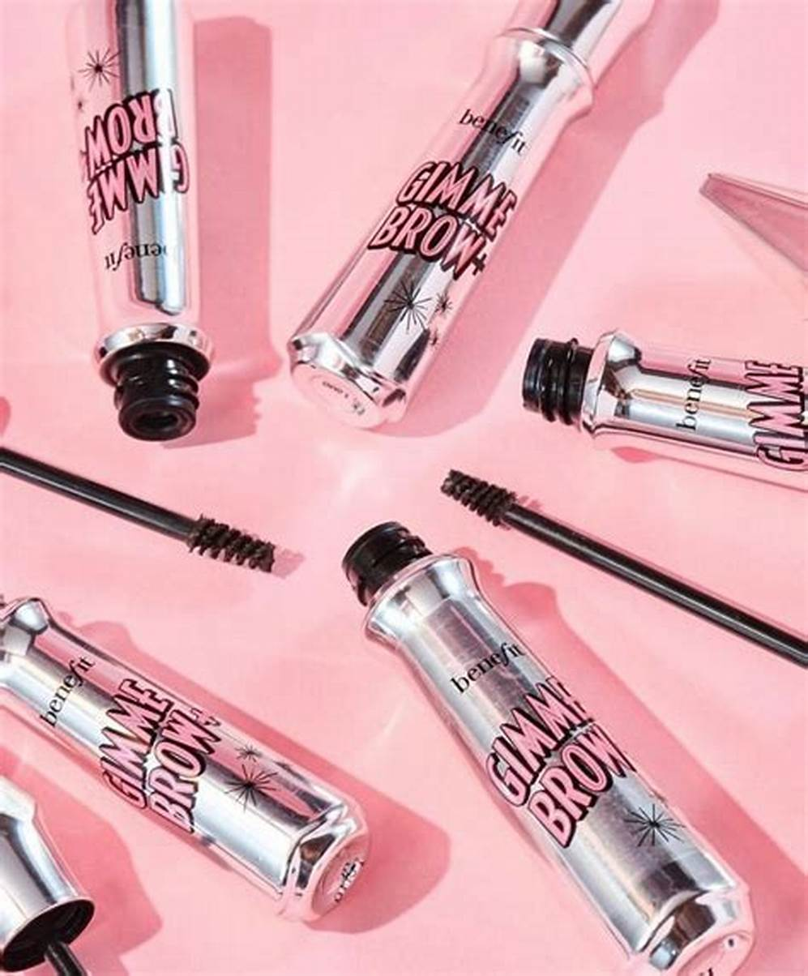


Overview
Nykaa, officially known as FSN E-Commerce Ventures Ltd, is an Indian retail company headquartered in Mumbai. Founded in April 2012 by Falguni Nayar, a former managing director at Kotak Mahindra Capital Company, Nykaa started as an e-commerce portal curating beauty and wellness products.
Total Revenue
Nykaa's total revenue for the year 2024 (TTM) is approximately ₹72.34 billion. This marks a significant increase from previous years, with ₹60.19 billion in 2023 and ₹48.15 billion in 2022
Nykaa sells products which are manufactured in India as well as internationally. In 2015, the company expanded from online-only to an omnichannel model and began selling products apart from beauty
Mission
To create a world where our consumers have access to a finely curated, authentic assortment of products and services that delight and elevate the human spirit

Slide 3

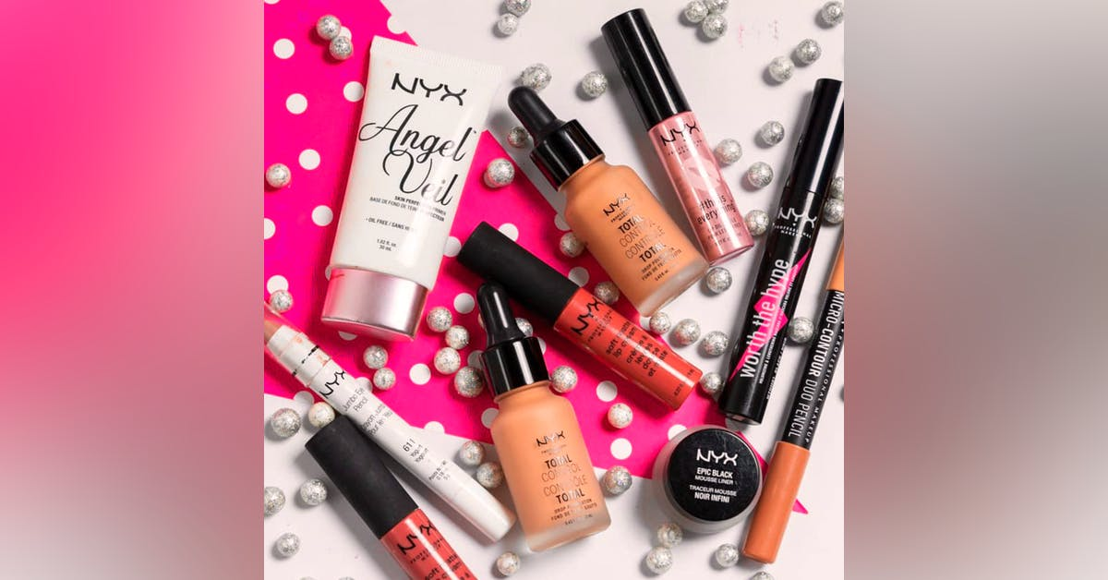
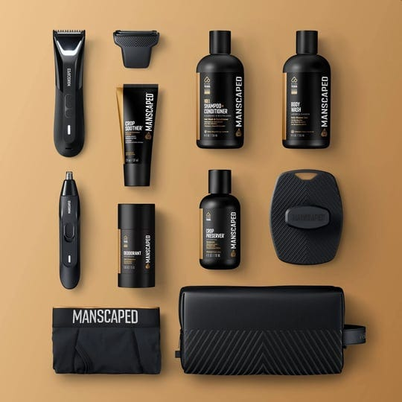
Nykaa Services
01.
02.
Nykaa Fashion
Nykaa Luxe
Offers a wide selection of clothing, footwear, accessories, and more from both international and Indian designers
Features premium skincare, cosmetics, perfumes, and haircare from globally renowned brands such as Chanel, Estée Lauder and more
03.
04.
Nykaa Man
Nykaa Prive
Caters to the men’s grooming segment through Nykaa Man, offering a wide range of products for skincare, haircare, grooming, and fragrances specifically designed for men.
Loyalty program offering benefits to customers who shop frequently on the platform. Members can enjoy exclusive discounts, early access to sales, birthday gifts, and other special privileges

Slide 4
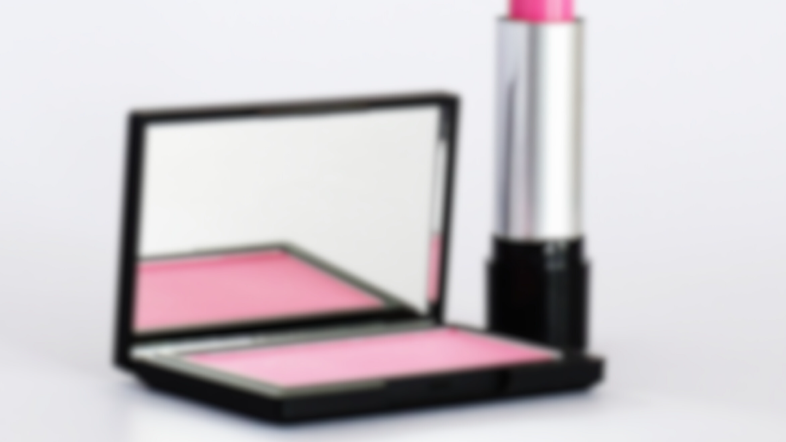
Business Model
Nykaa's business model is an excellent example of how a company can successfully blend e-commerce and physical retail to cater to a wide range of customers.
Omni-Channel Presence
Curated Products
Content-Driven Commerce
Nykaa operates both online and offline. Their online platform offers a vast selection of beauty, wellness, and fashion products. Additionally, they have physical stores in various formats, including Nykaa Luxe and Nykaa On Trend.
Nykaa offers a curated selection of products from top brands, ensuring high quality and authenticity. They also have private label products under their brands like Nykaa Cosmetics, Nykaa Naturals, and Kay Beauty
Nykaa uses content, such as tutorials, reviews, and beauty tips, to engage customers and drive sales. Their website and app feature detailed product descriptions, how-to videos, and customer reviews, helping users make informed decisions
Personalized Experience
Diverse Product Range
Exclusive Collaborations
Nykaa offers a wide range of products catering to various customer needs, including beauty, wellness, fashion, men’s grooming, and innerwear. Nykaa has partnered with numerous global brands to offer their products in India, ensuring a diverse and comprehensive product lineup.
Nykaa collaborates with celebrities, influencers, and brands to launch exclusive collections and limited-edition products, driving interest and sales.
Nykaa uses data analytics and AI to provide personalized recommendations, offers, and content to their customers. This enhances the shopping experience and builds customer loyalty.

Slide 5
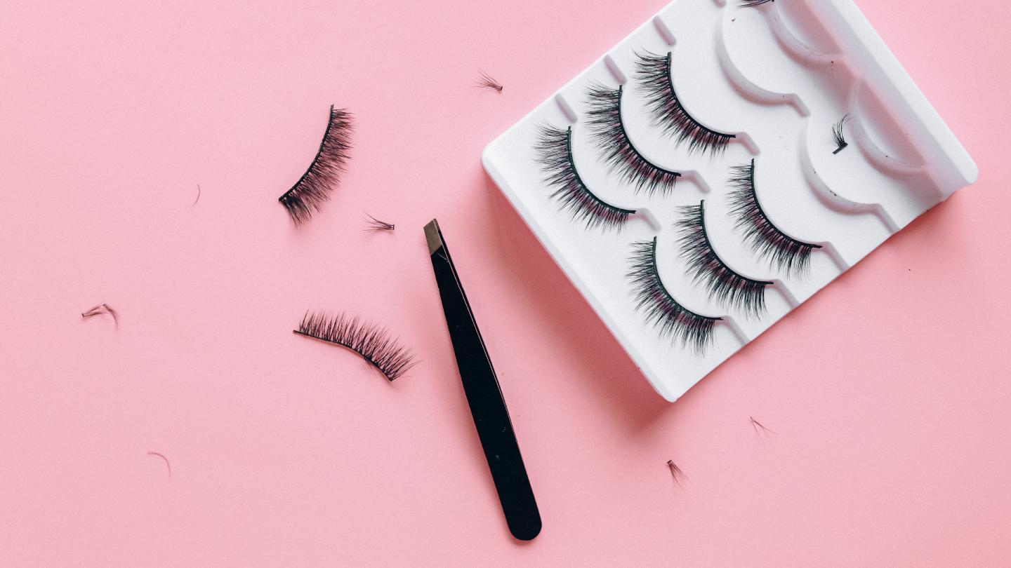
Brand Perception
Nykaa has successfully created a strong, positive brand perception as a trusted, premium, and accessible beauty and fashion brand in India. Its strategic use of influencer marketing, seamless digital experience, focus on authenticity, and commitment to diversity have contributed to its appeal. However, maintaining its premium image while staying competitive on price and product availability will continue to be a challenge as it grows and diversifies.
Premium yet Accessible
Strong Social Media and Influencer Presence
Key Aspects of Nykaa
Trust and Authenticity
Customer-Centric Service
Inclusive and Diverse Marketing
Sustainability Efforts

Slide 6
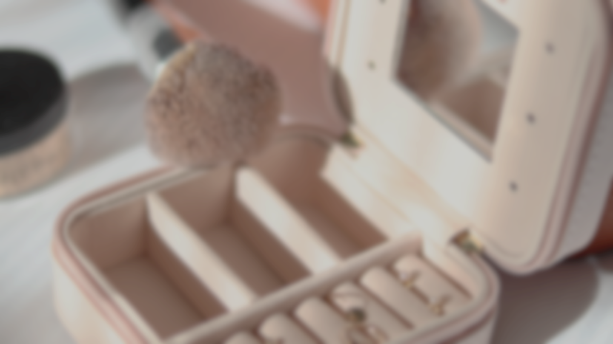

Technology Integration
Amazon Web Services
Nykaa utilizes AWS for cloud infrastructure, hosting its platform and ensuring reliable, scalable, and secure data management
AI & Machine Learning
Nykaa offers a visual search feature powered by AI, allowing users to search for products using images
Data Analytics
Nykaa utilizes Big Data tools like Hadoop and Spark to handle large volumes of customer data. This helps in analyzing customer behavior, inventory management, and marketing insights
Augmented Reality (AR)
Nykaa has started using Augmented Reality (AR) technology for features like virtual try-ons for makeup products, allowing users to see how products might look on their faces before making a purchase
Artificial Intelligence (AI) for Fraud Detection
AI-driven systems are used for detecting and preventing fraudulent activities related to online transactions and user accounts

Slide 7
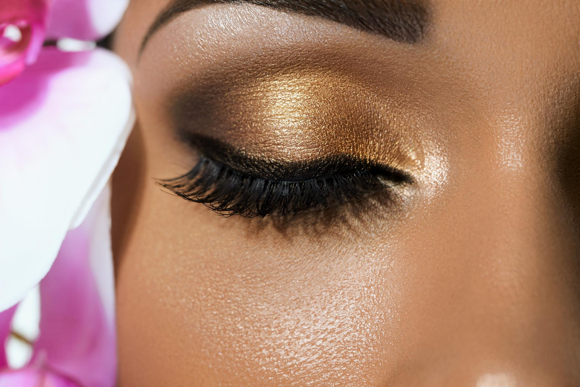
SWOT Analysis
Strength:
Strong Brand Recognition : Nykaa has established itself as a trusted name in beauty and personal care, both online and offline
Content-Driven Approach: Engages customers through beauty tutorials, expert talks, and product reviews
Omnichannel Presence: Effective integration of online and offline stores, enhancing brand visibility
Opportunities:
Expansion into Tier-II and Tier-III Cities: Potential to tap into new markets and increase customer base.
Growth in Men's Grooming Segment: Increasing demand for men's beauty and personal care products.
Weakness:
Customer Service Issues: Some customers have reported issues with product delivery and customer service
High Dependence on Beauty and Personal Care Segment: Heavy reliance on this segment makes it vulnerable to market fluctuations
Threats:
Intense Competition: Facing stiff competition from other e-commerce giants like Amazon and Flipkart.
Market Saturation: The beauty and personal care market in India is becoming increasingly saturated

Slide 8
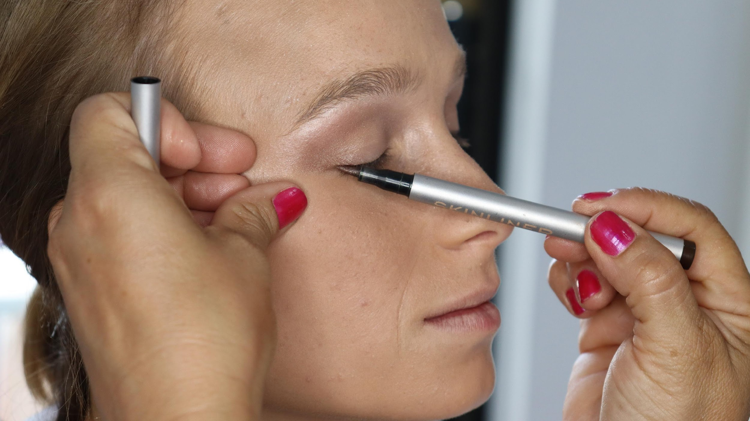
Key Competitors
Myntra
Myntra is one of India's leading e-commerce platforms specializing in fashion and lifestyle products. It offers a wide range of apparel, footwear, accessories, beauty products, and home décor from both global and local brands
Global Rank # 1146
Purplle
An online beauty and wellness platform offering a wide range of products.
Global Rank # 19,306
Mamaearth
Mamaearth is one of the leading company or a brand which intends to make lives of mums & expectant mums better and beautiful
Global Rank # 28,726
TataCliq
Ecommerce company based in Mumbai. It is an Omni-Channel marketplace model.
Global Rank # 9660
Sugar Cosmetics
It focuses on selling makeup and skincare products that are millennial friendly, best suited for Indian skin tones and are cruelty-free
Global Rank # 2,56,142

Slide 9
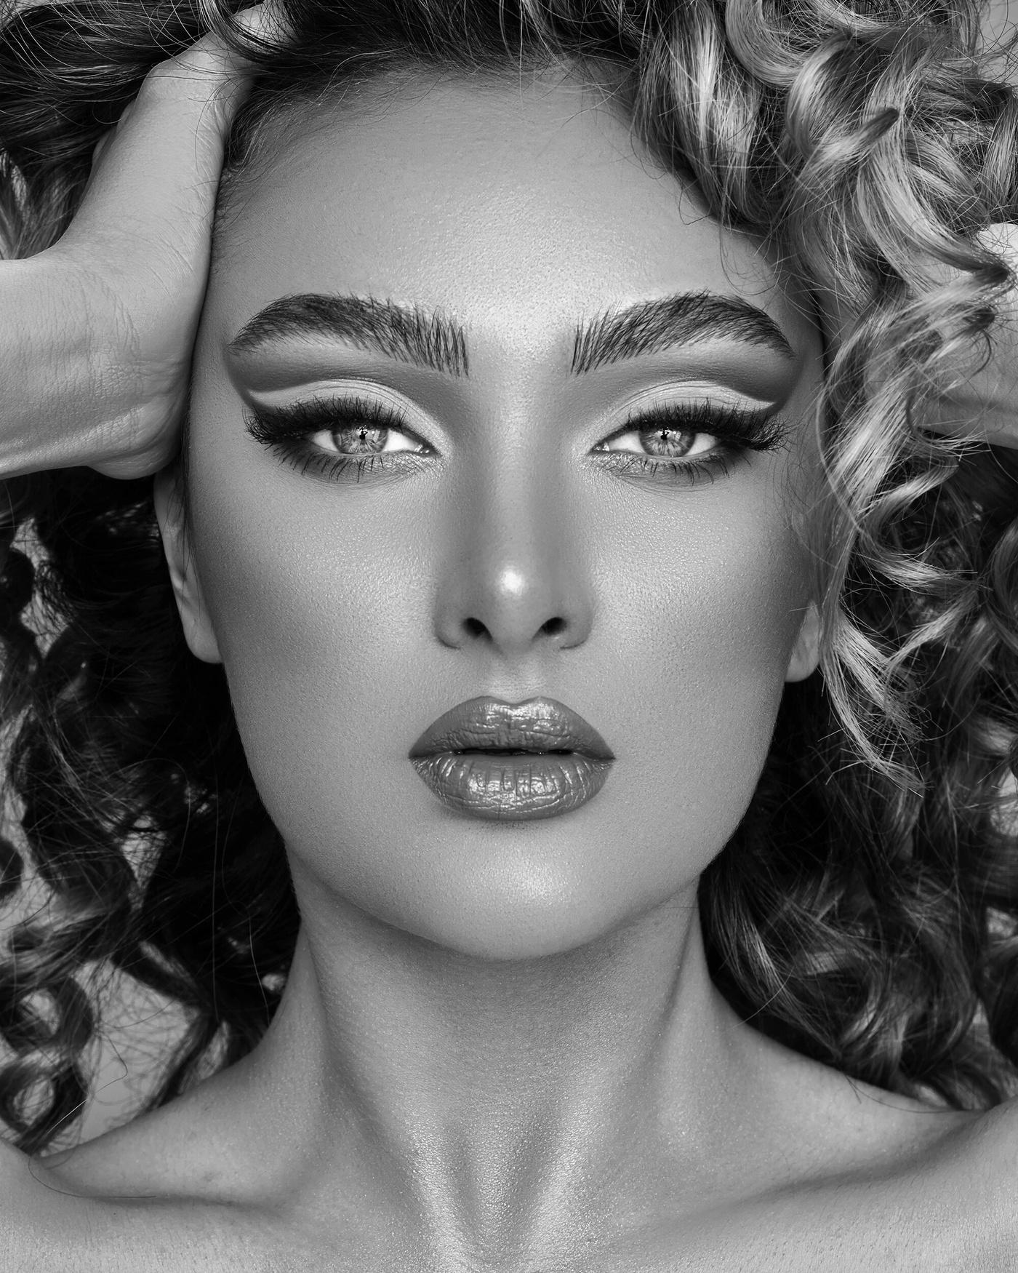
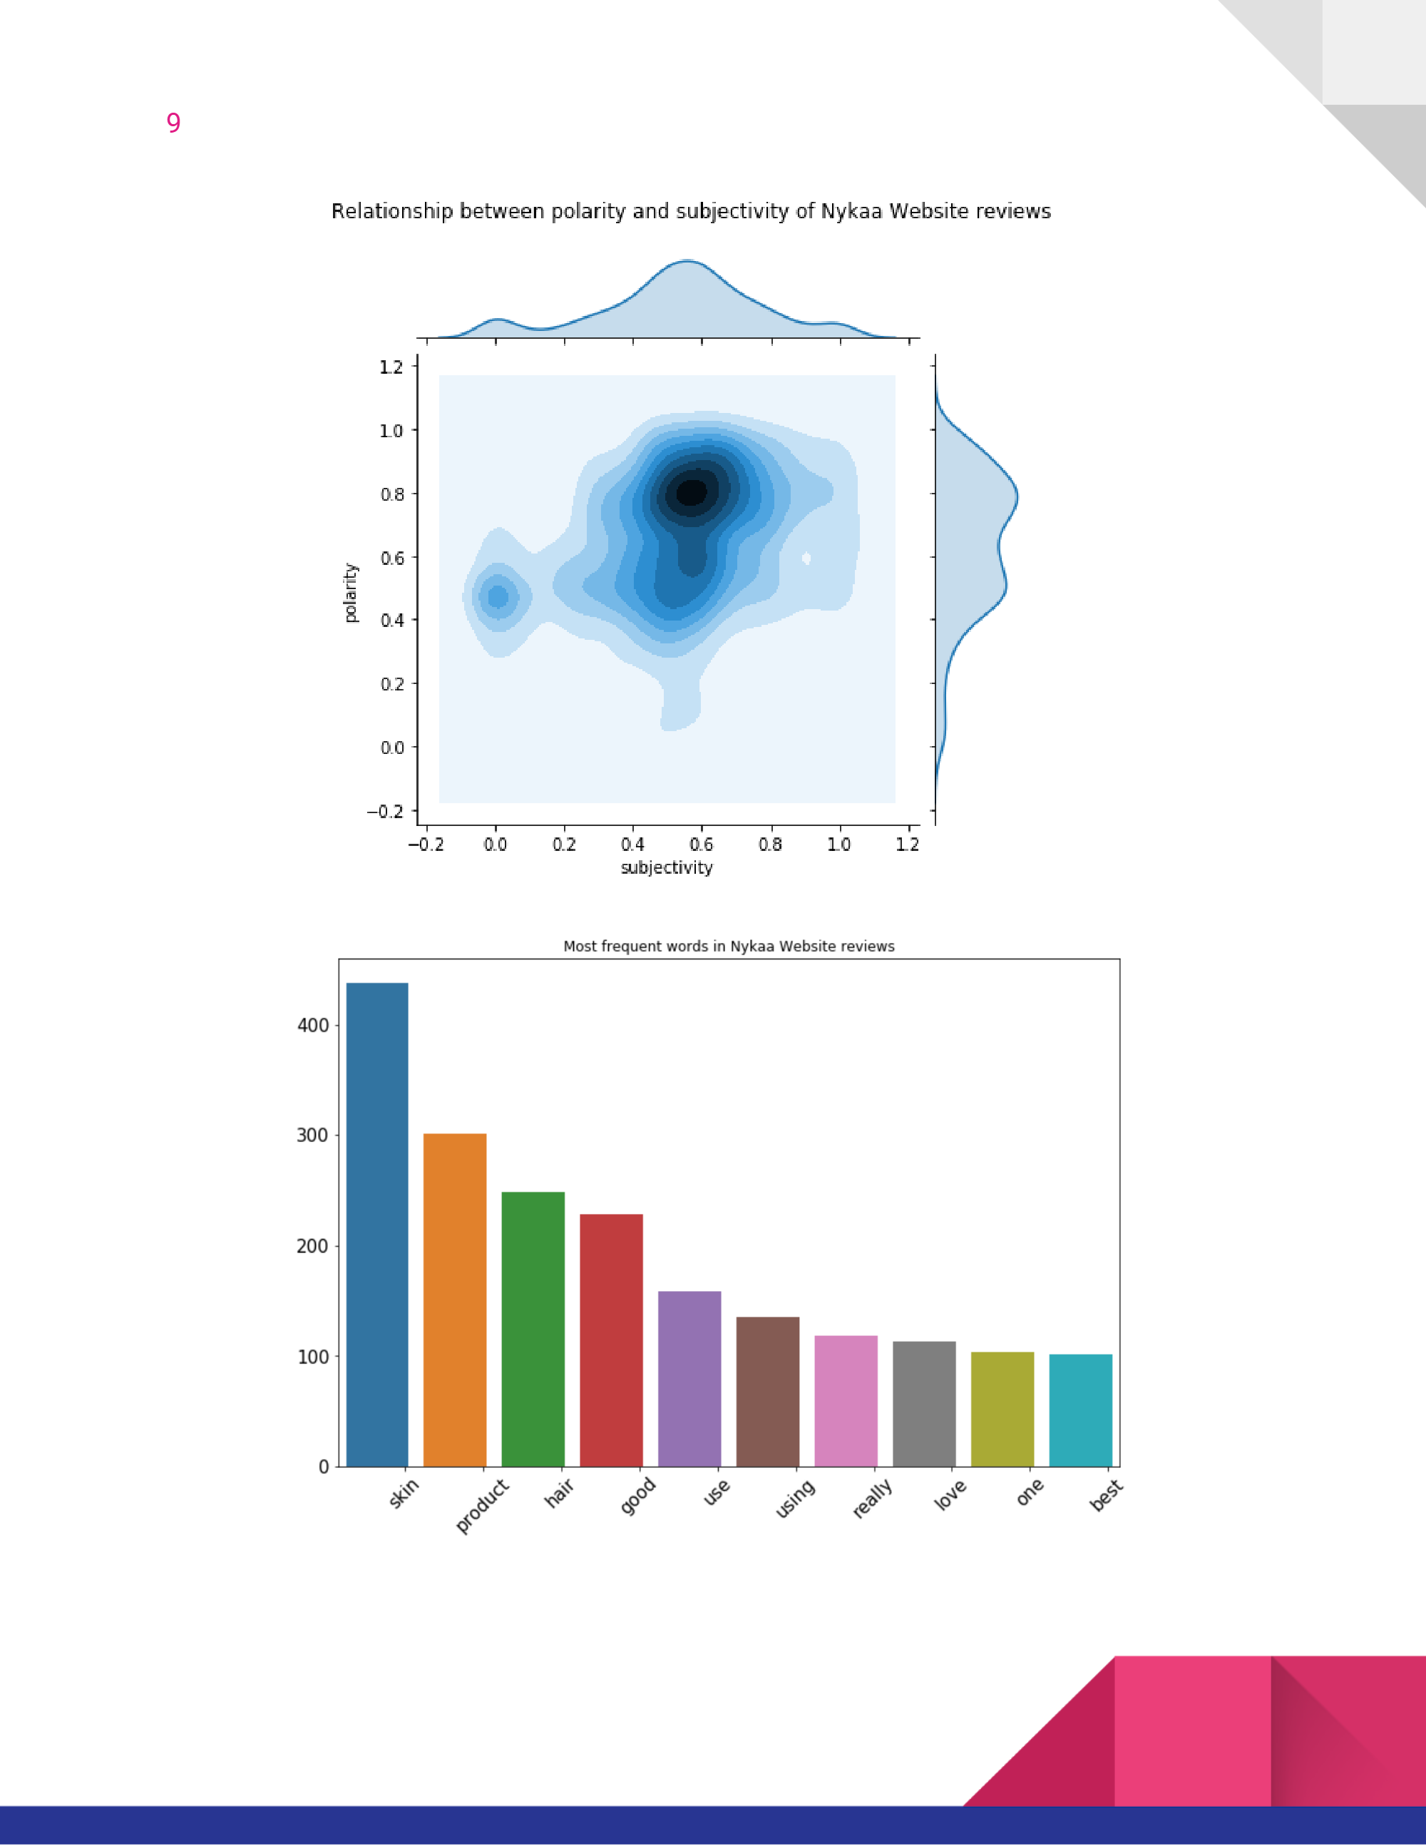
Sentiment Analysis
Sentiment analysis is a popular task in natural language processing. The goal of sentiment analysis is to classify the text based on the mood or mentality expressed in the text, which can be positive negative, or neutral. Today, companies have large volumes of text data like emails, customer support chat transcripts, social media comments, and reviews. Sentiment analysis tools can scan this text to automatically determine the author’s attitude towards a topic. Companies use the insights from sentiment analysis to improve customer service and increase brand reputation

Slide 10
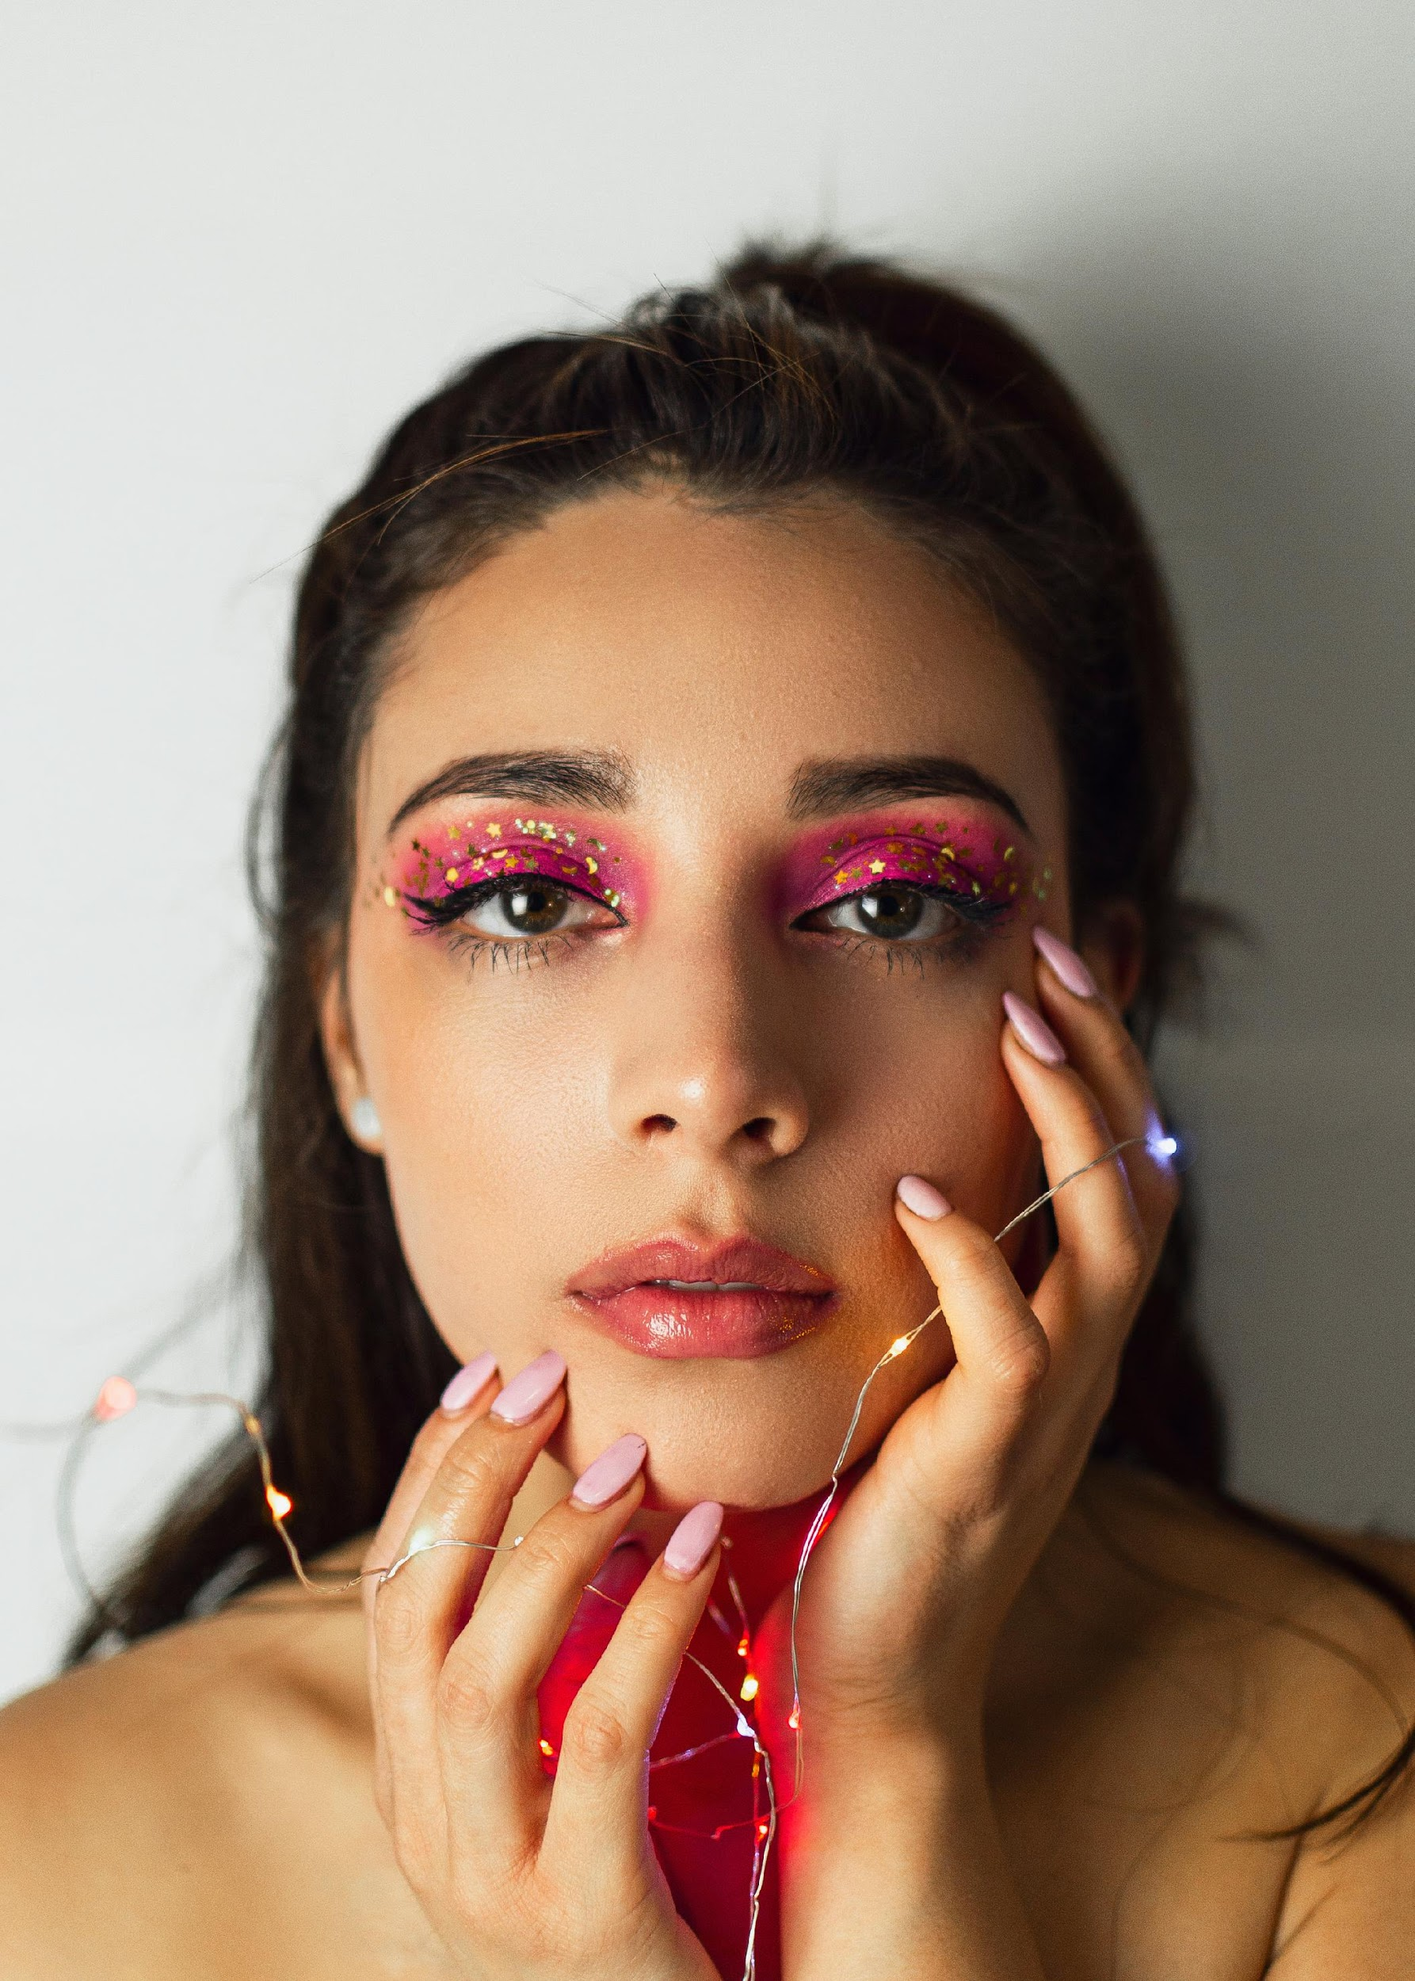
Positive Sentiments
Extensive product Range
Customers value the wide variety of beauty, skincare, and wellness products available, catering to diverse needs and preferences
User-Friendly Interface
The website and app are easy to navigate, providing a seamless shopping experience
Authenticity and Quality
Users trust the authenticity of Nykaa's products, a major factor driving positive reviews
Attractive Offers and Discounts
Frequent sales and promotional deals are appreciated for their affordability and value
Positive In-Store Experiences
Physical stores and events, such as makeovers and workshops, offer personalized services that customers enjoy

Slide 11
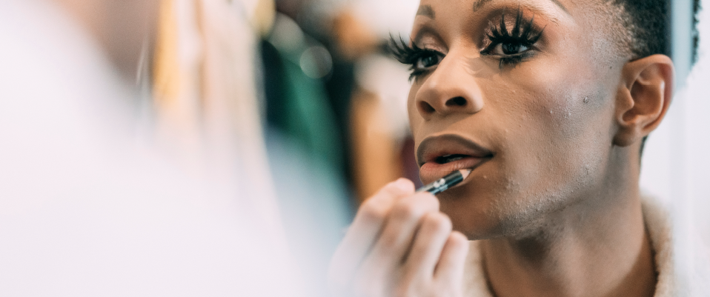
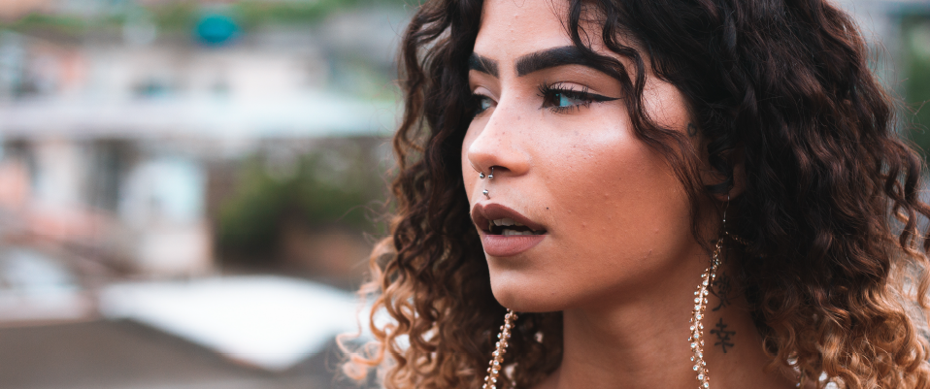
Negative Sentiments
Customer Service Issues
Many customers report dissatisfaction with Nykaa's customer support, citing unresponsiveness and inadequate assistance
Return and Refund Challenges
Users have expressed frustration with Nykaa's return and refund policies, describing them as cumbersome and inefficient. Complaints include delays in processing returns and refunds, with some customers alleging that their requests were ignored or denied without proper justification
Delivery Delays
Several reviews mention issues with delivery timelines, including significant delays and, in some cases, non-receipt of orders. Such experiences have led to inconvenience and dissatisfaction among customers
Packaging Concerns
A few reviews mention damaged products or poor packaging leading to spillage or breakage

Slide 12

Emerging Trends from 2024
Late-night shopping – Nykaa reported a 60% increase in midnight purchases. During late hours, customers mostly shopped for lipsticks, serums, and sheet masks
Demand for Korean beauty products - As the concept of glass skin gains popularity among Indian consumers, the demand for Korean products rose 2.5 times faster than the average, especially for brands such as COSRX, TONYMOLY, The Face Shop, and LANEIGE
Men prefer luxury products - Male shoppers are opting for luxury products. Luxury fragrances such as Dior, Clinique, Davidoff, and YSL are sold every 10 minutes. Some popular luxury skincare brands among men are Kama Ayurveda, Kiehl’s, and Clinique
Science in skincare - Consumers are checking for specific ingredients in products to target certain skin concerns. The search for peptide booster serums, alpha arbutin, and ceramide mochi toners surged by 150%
Social media trends - Off-shoulder tops, wide-leg jeans, and waistcoats are some of the fashion trends that have dominated social media in 2024
Regional choices - In terms of region, customers from Delhi preferred kurta sets, Mumbai customers favoured co-ords sets while Bengaluru consumers shopped for lehengas. Among men, consumers from Jaipur leaned towards stylish jackets

Slide 13
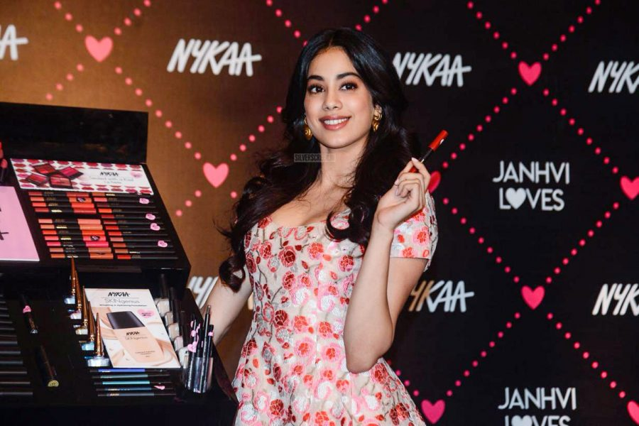
Brand Ambassador
Janhvi Kapoor, a prominent Bollywood actress, has been closely associated with Nykaa, serving as a brand ambassador for both Nykaa Beauty and Nykaa Fashion. Her collaborations have significantly enhanced the brand's visibility and appeal among young consumers.
“My relationship with Nykaa is truly special, not just professionally but also personally. As one of their millions of consumers, I have always felt empowered by the choices offered by the brand”

Slide 14

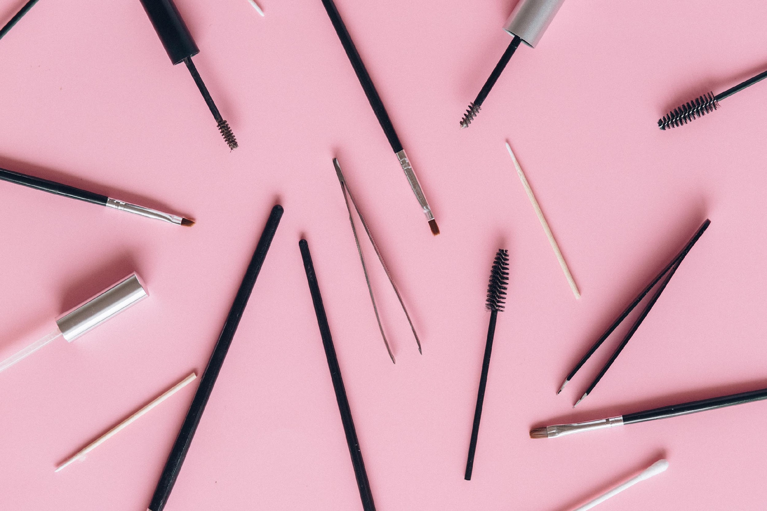
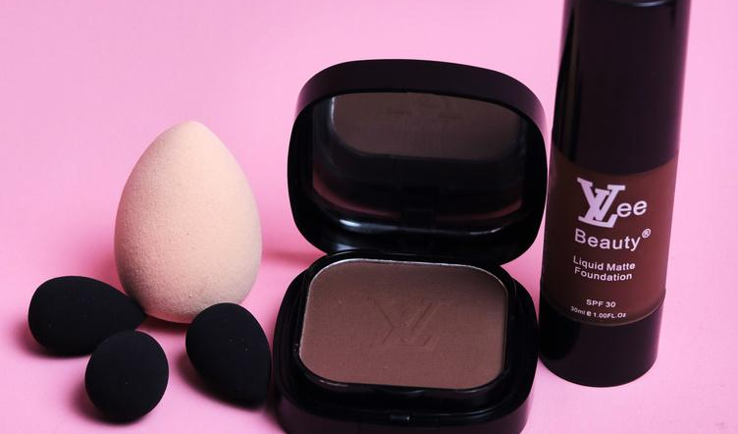
Strategic Recommendation
Expand Product Offerings - Introduce more niche categories such as eco-friendly beauty, luxury fashion collaborations, and inclusive skin tone shades
Focus on Tier 2 and 3 Markets - Develop region-specific content and product launches catering to cultural preferences
Enhanced Customer Engagement - Utilize quizzes, challenges, and points systems to keep customers engaged on the platform
Sustainability and Ethical Practices - Highlight eco-conscious offerings and green beauty options

Slide 15
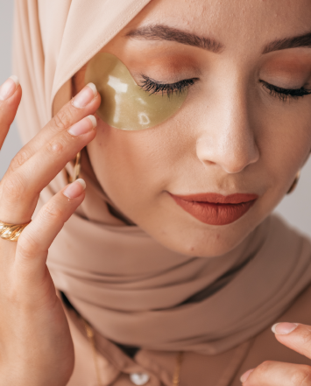
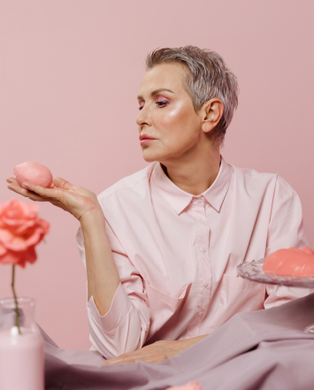
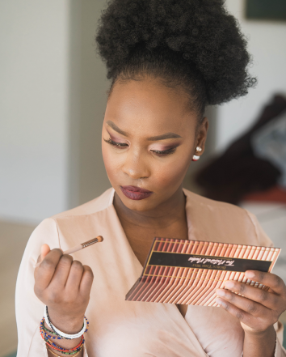
thank you

